Slide 1


Slide 2
85%
Nick Heudecker‏ (Gartner analyst)

Slide 3
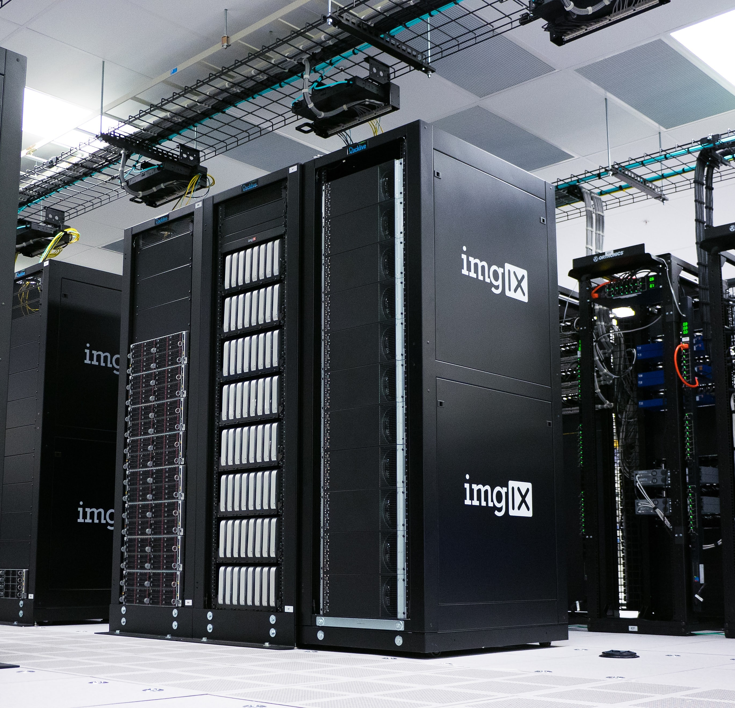


Slide 4
Getting your R project into production using Databricks

Slide 5

What we will talk about
Data science lifecycle
Spark and R
Databricks

Slide 6
Data Science Lifecycle
Notes:
CRISP-DM
Team Data Science Process

Slide 7
Problem
Problem
Acquire Data
Model
Deployment

Slide 8


Slide 9

2003
Google File System (GFS)
Predecessor to HDFS
History of Azure Databricks

Slide 10

MapReduce
2004
2003
Google File System (GFS)
Predecessor to HDFS
History of Azure Databricks

Slide 11


MapReduce
Spark
2004
2012
2003
2006
Google File System (GFS)
Apache Hadoop Project
Predecessor to HDFS
History of Azure Databricks

Slide 12




DataFrames API / SQL
Streaming
Graph
Machine Learning

Slide 13
MapReduce
Spark
2004
2012
2003
2006
2013
Google File System (GFS)
Apache Hadoop Project
Databricks
Predecessor to HDFS
History of Azure Databricks

Slide 14
DataFrames API / SQL
Streaming
Graph
Machine Learning

Slide 15
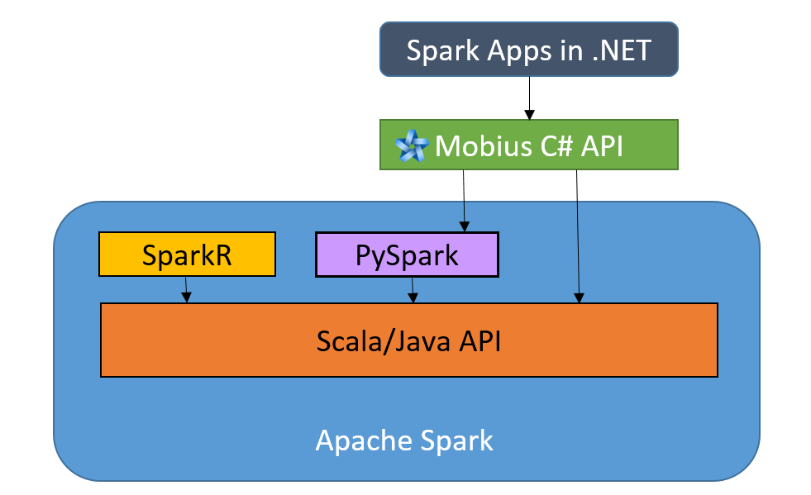

Slide 16
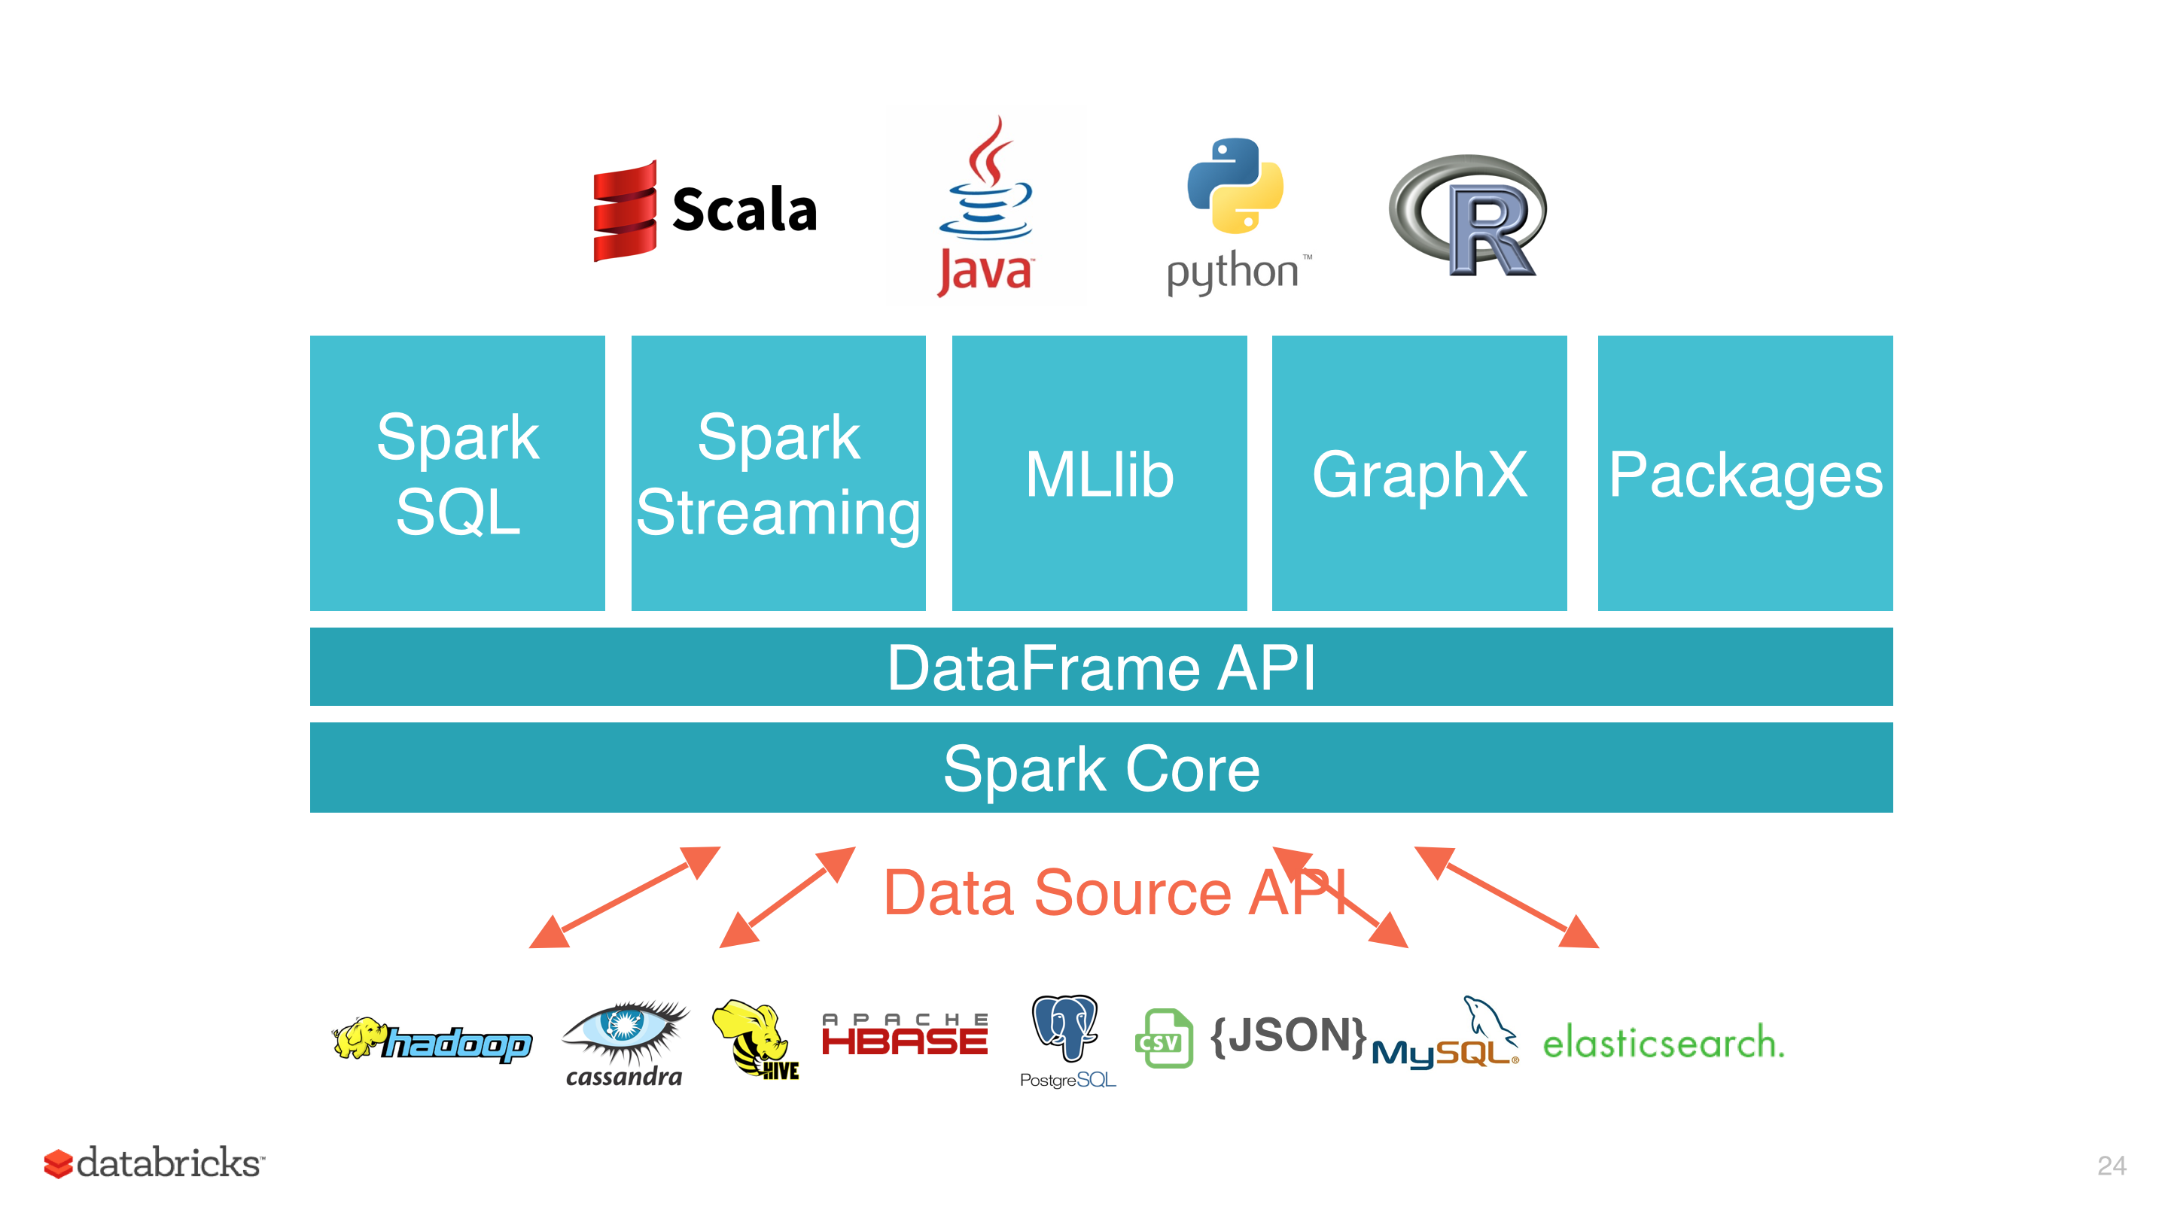

Slide 17
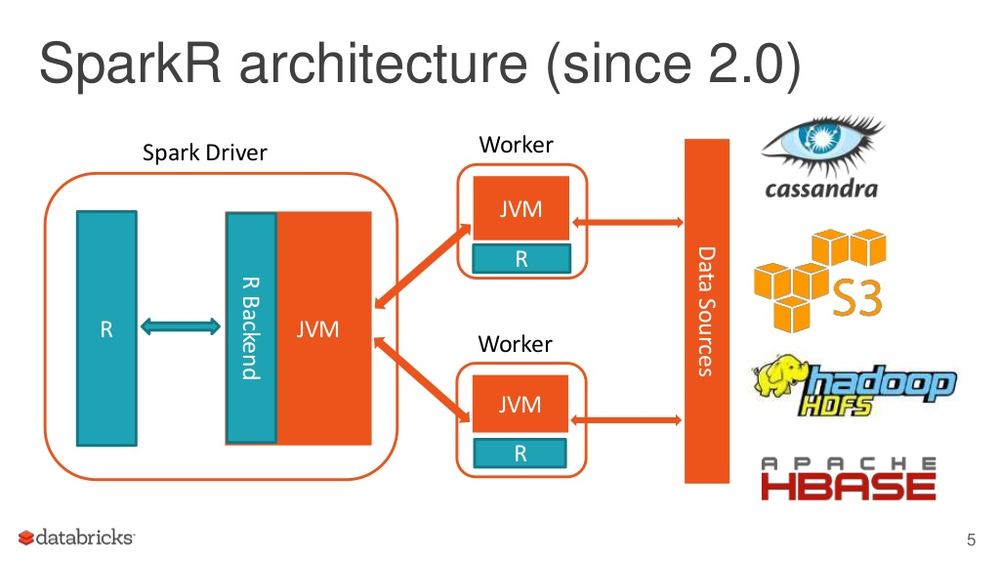

Slide 18
Data bricks

Slide 19


Implementation

